Slide 1
VAST CHALLENGE
2018 MC 1
Third Progress
Group Project by :
Batuhan Kir
Jun Yan Chen
Shravika Pinna
Chinmai Reddy Modugula
Kamal Afridi M S

Slide 2
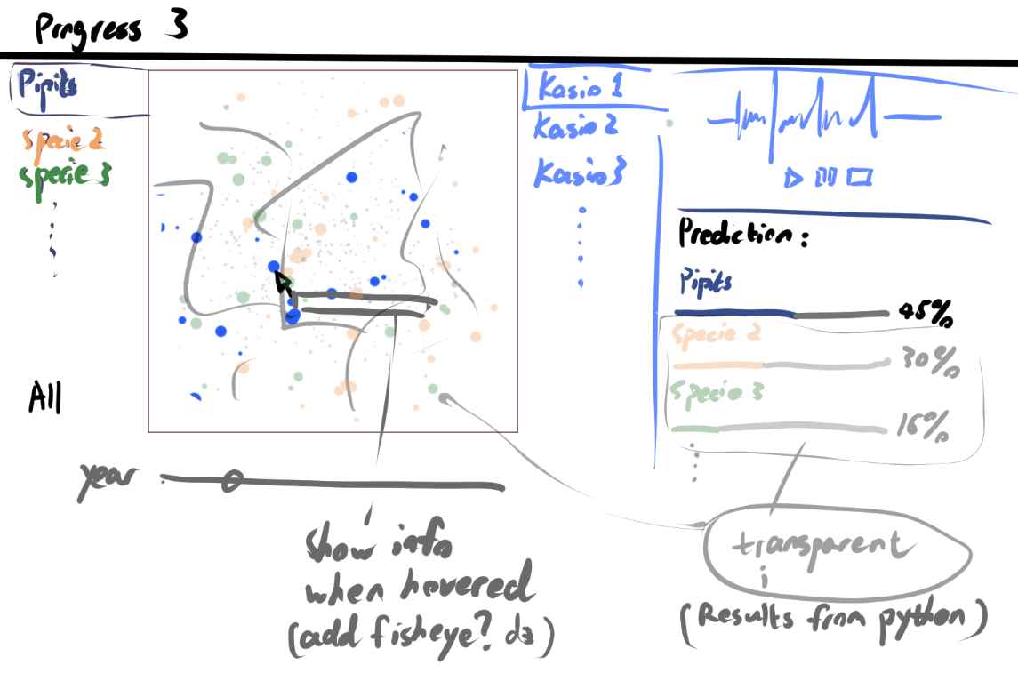
Sketch

Slide 3
Contributions
Jun Yan Chen - Loading Mitch Data on D3 map (blue dots) & Sketch and Design
Batuhan Kir - Loading Kasios Data on D3 map (blue dots) & Helped with wavesurfer.
Shravika Pinna - Display bird details when hovered & Select and organize audio samples.
Chinmai Reddy M - Display audio waveforms using wavesurfer.js
Kamal Afridi M S - Display prediction results & Styling with CSS

Slide 4
Feature Summary
When selecting a bird specie on the list on the left
D3 map displays the bird location for only the selected specie as blue dots.
Click on the “Select a bird specie” or “Compare with Mitch Audio” to show the audio samples for the selected bird specie.
Click on “Prediction Results” to display the results from the machine learning prediction.
When selecting a Kasios sample on the middle-right list
D3 map displays the location of the selected Kasios sample as big yellow dots.
Audio file for the selected sample will be displayed on the top right section as waveform.
Hovering on any blue dots will display the all the attributes of that specific unit.

